Slide 1

LIBRARY DATABASE ANALYSIS

Slide 2
About me :
Pavan Akuthota
MBA in Systems and Information Technology
LinkedIn | Github

Slide 3
Project Agenda – SQL Library Database Analysis
Objective of the Project
Key Analysis Questions (Use Cases)
Conclusion – Key Findings
Q&A
My Experience & Challenges

Slide 4
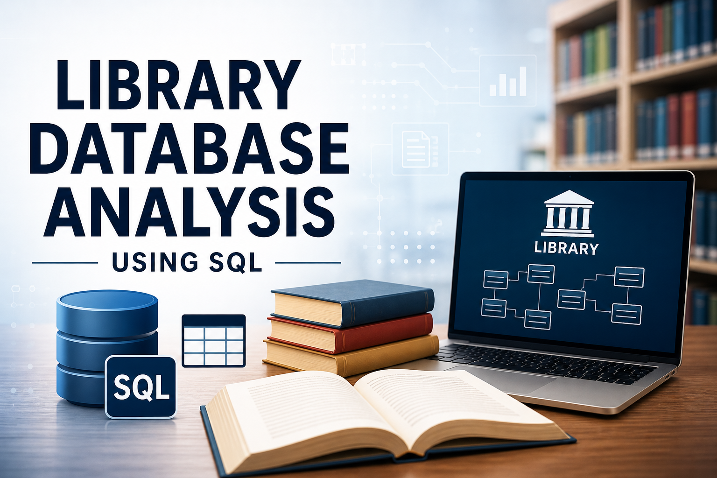
Objective of the Project
To design and implement a Library Management System using SQL relational database concepts.
To efficiently manage library records such as books, borrowers, authors, publishers, branches, and book loans.
To establish relationships between tables using Primary Keys and Foreign Keys.
To perform SQL-based data analysis and generate useful insights from the library database.
To improve database management, querying, and analytical skills through real-world use cases.
To Strengthen skills in database design, Query writing and analytical problem solving.

Slide 5
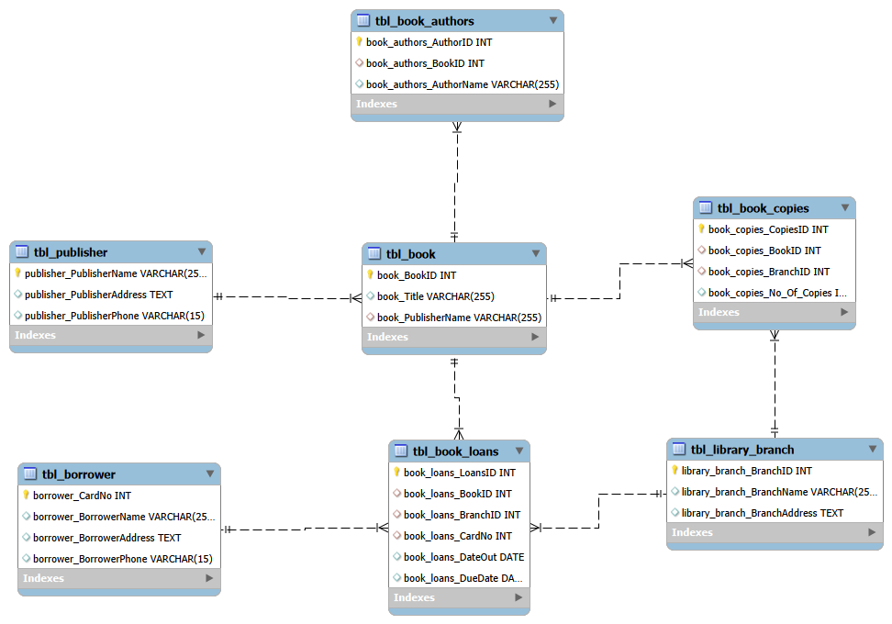
System Design Overview
ER Diagram:

Slide 6
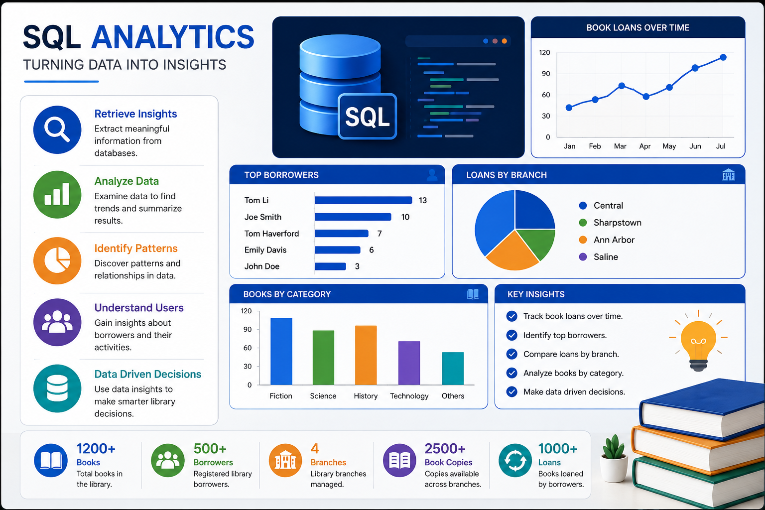
Key Analysis Use Cases – Library Database

Slide 7
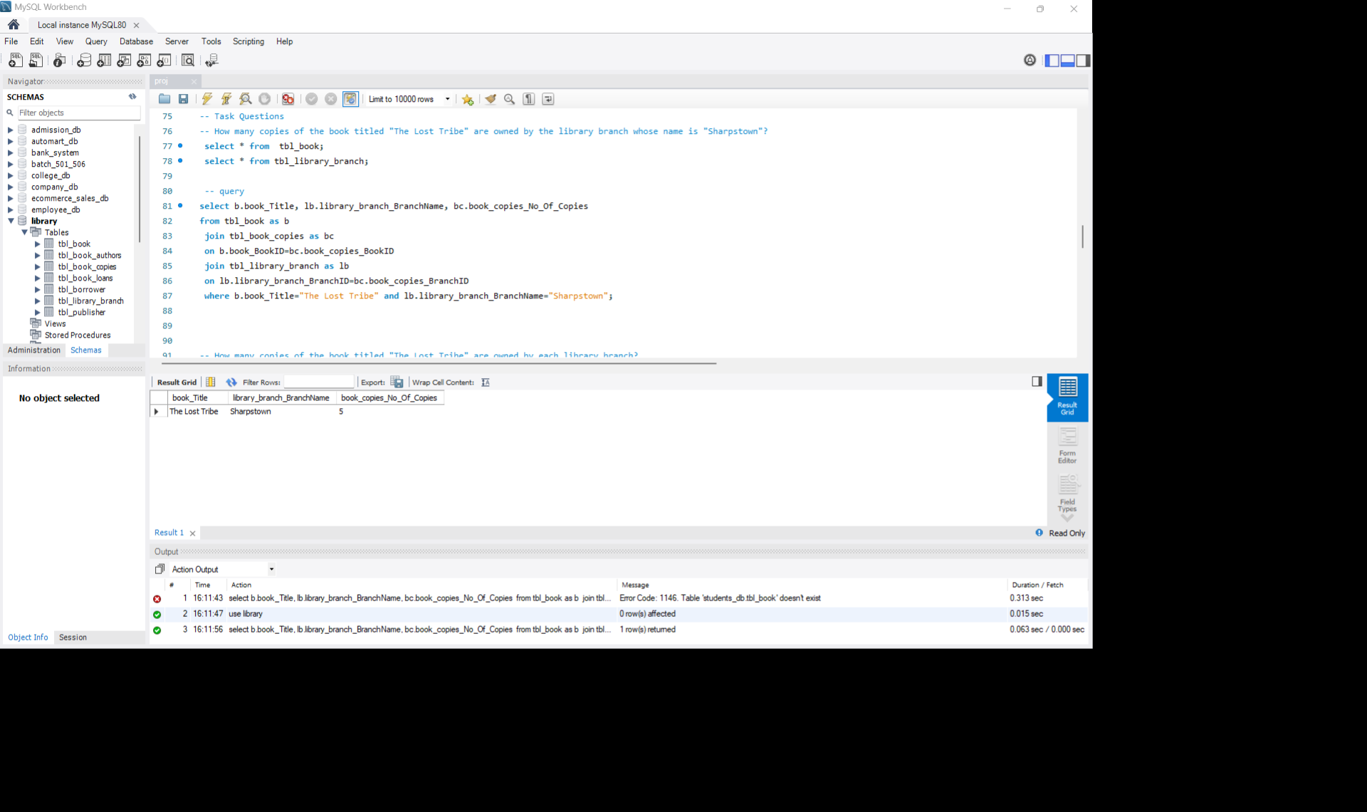
Q1: How many copies of the book titled "The Lost Tribe" are owned by the library branch whose name is "Sharpstown"?
Query
Output
Observation:
The query joins the tbl_book , tbl_book_copies , and tbl_library_branch tables using their respective foreign key relationships. It filters records where the book title is “The Lost Tribe” and the branch name is “Sharpstown”.
Result:
The output shows that the Sharpstown branch owns 5 copies of the book “The Lost Tribe”.
Insight:
Shows availability of a specific book in the Sharpstown branch.
Helps librarians manage branch-wise inventory.
Useful for checking whether enough copies are available for readers..

Slide 8
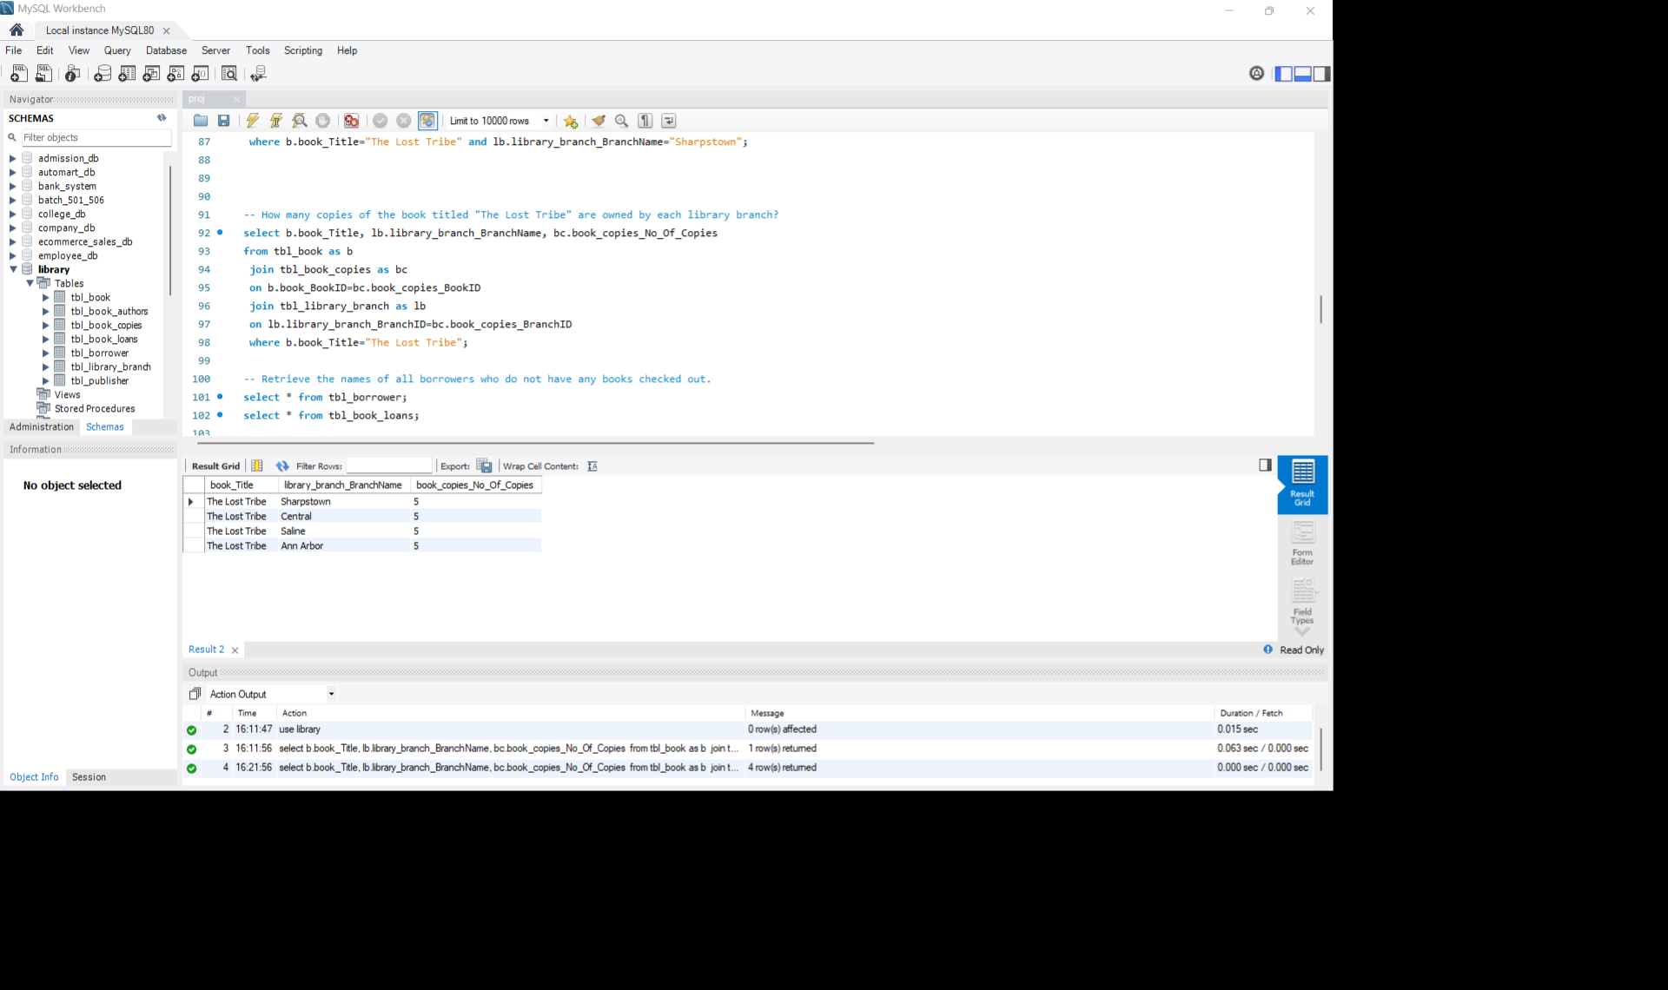
Q2 :How many copies of the book titled "The Lost Tribe" are owned by each library branch?
Query
Output
Observation:
The query joins the tbl_book, tbl_book_copies, and tbl_library_branch tables using their foreign key relationships. It filters records where the book title is “The Lost Tribe” and retrieves the branch name along with the number of copies available in each branch.
Result:
The output shows that the book “The Lost Tribe” is available in four branches — Sharpstown, Central, Saline, and Ann Arbor — with 5 copies in each branch.
Insight:
This analysis helps the library understand how the copies of a specific book are distributed across branches and assists management in balancing inventory based on reader demand and branch requirements.

Slide 9
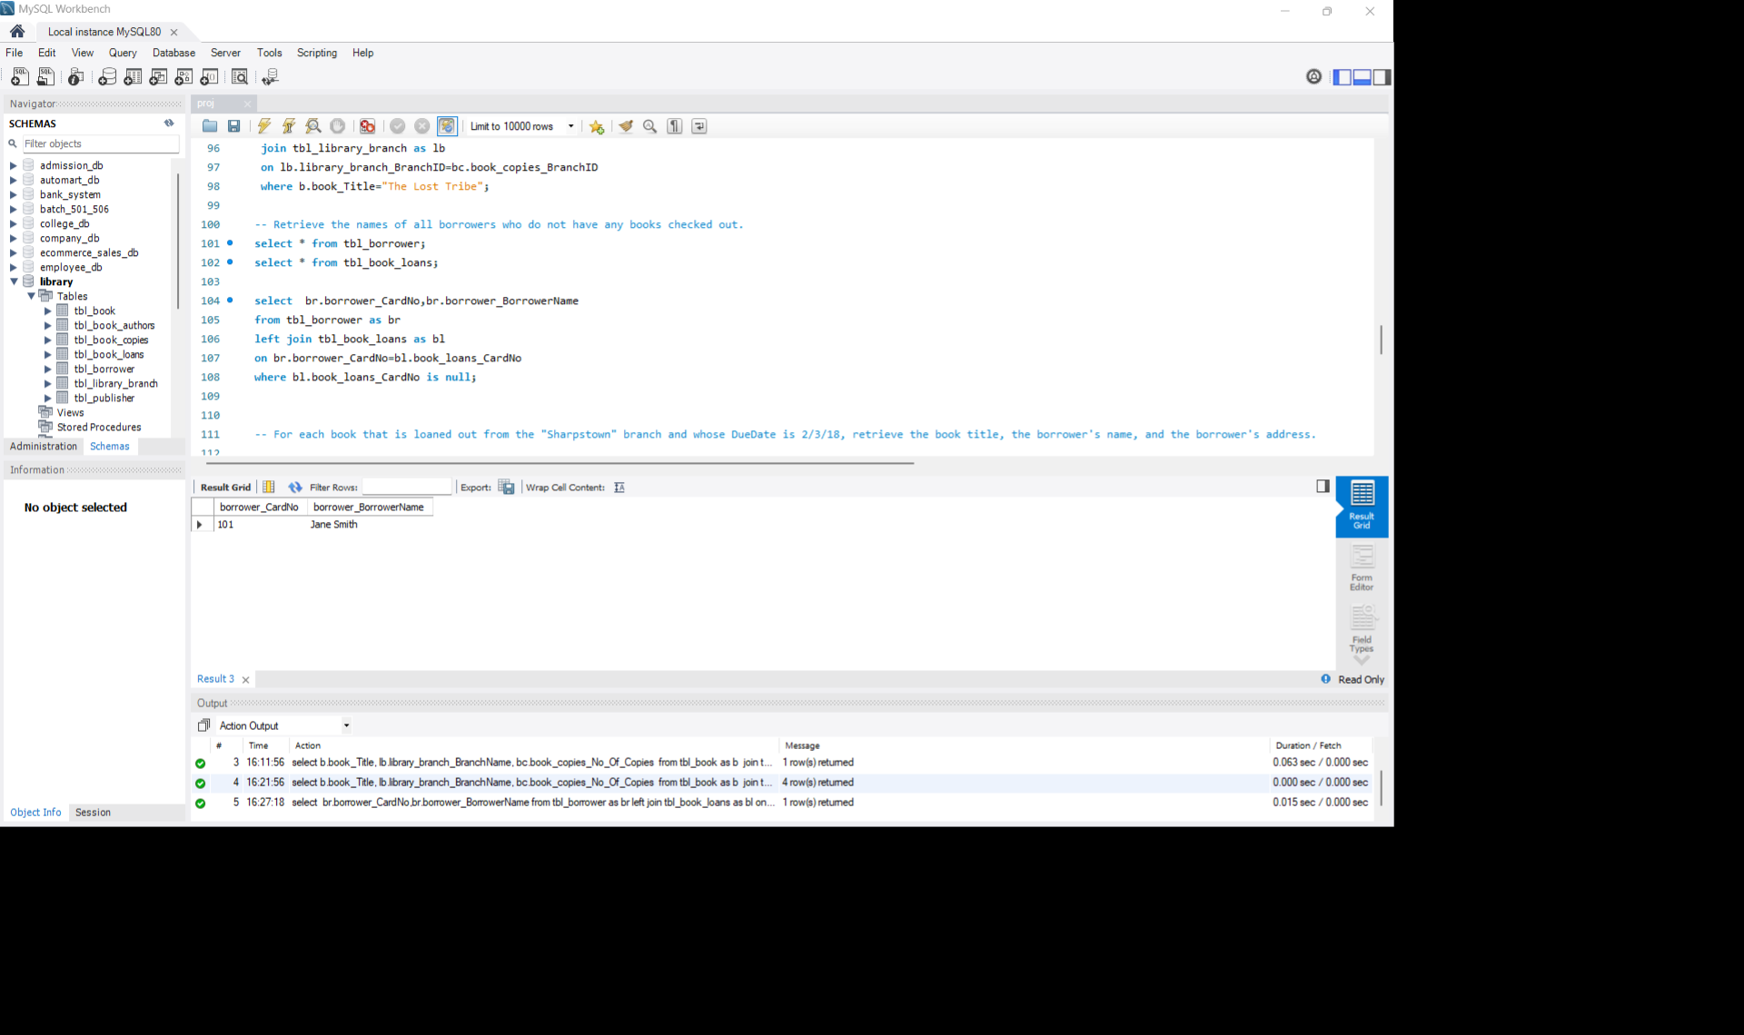
Q3 :Retrieve the names of all borrowers who do not have any books checked out.
Query
Output
Observation:
The query uses a LEFT JOIN between tbl_borrower and tbl_book_loans on the borrower’s card number. The condition WHERE bl.book_loans_CardNo IS NULL filters out borrowers who have no matching records in the tbl_book_loans table — meaning they haven’t borrowed any books.
Result:
The output shows that Jane Smith (Card No: 101) has not checked out any books.
Insight:
This query helps identify inactive borrowers and provides useful information for the library to improve user engagement by encouraging these members to utilize library resources more actively.

Slide 10
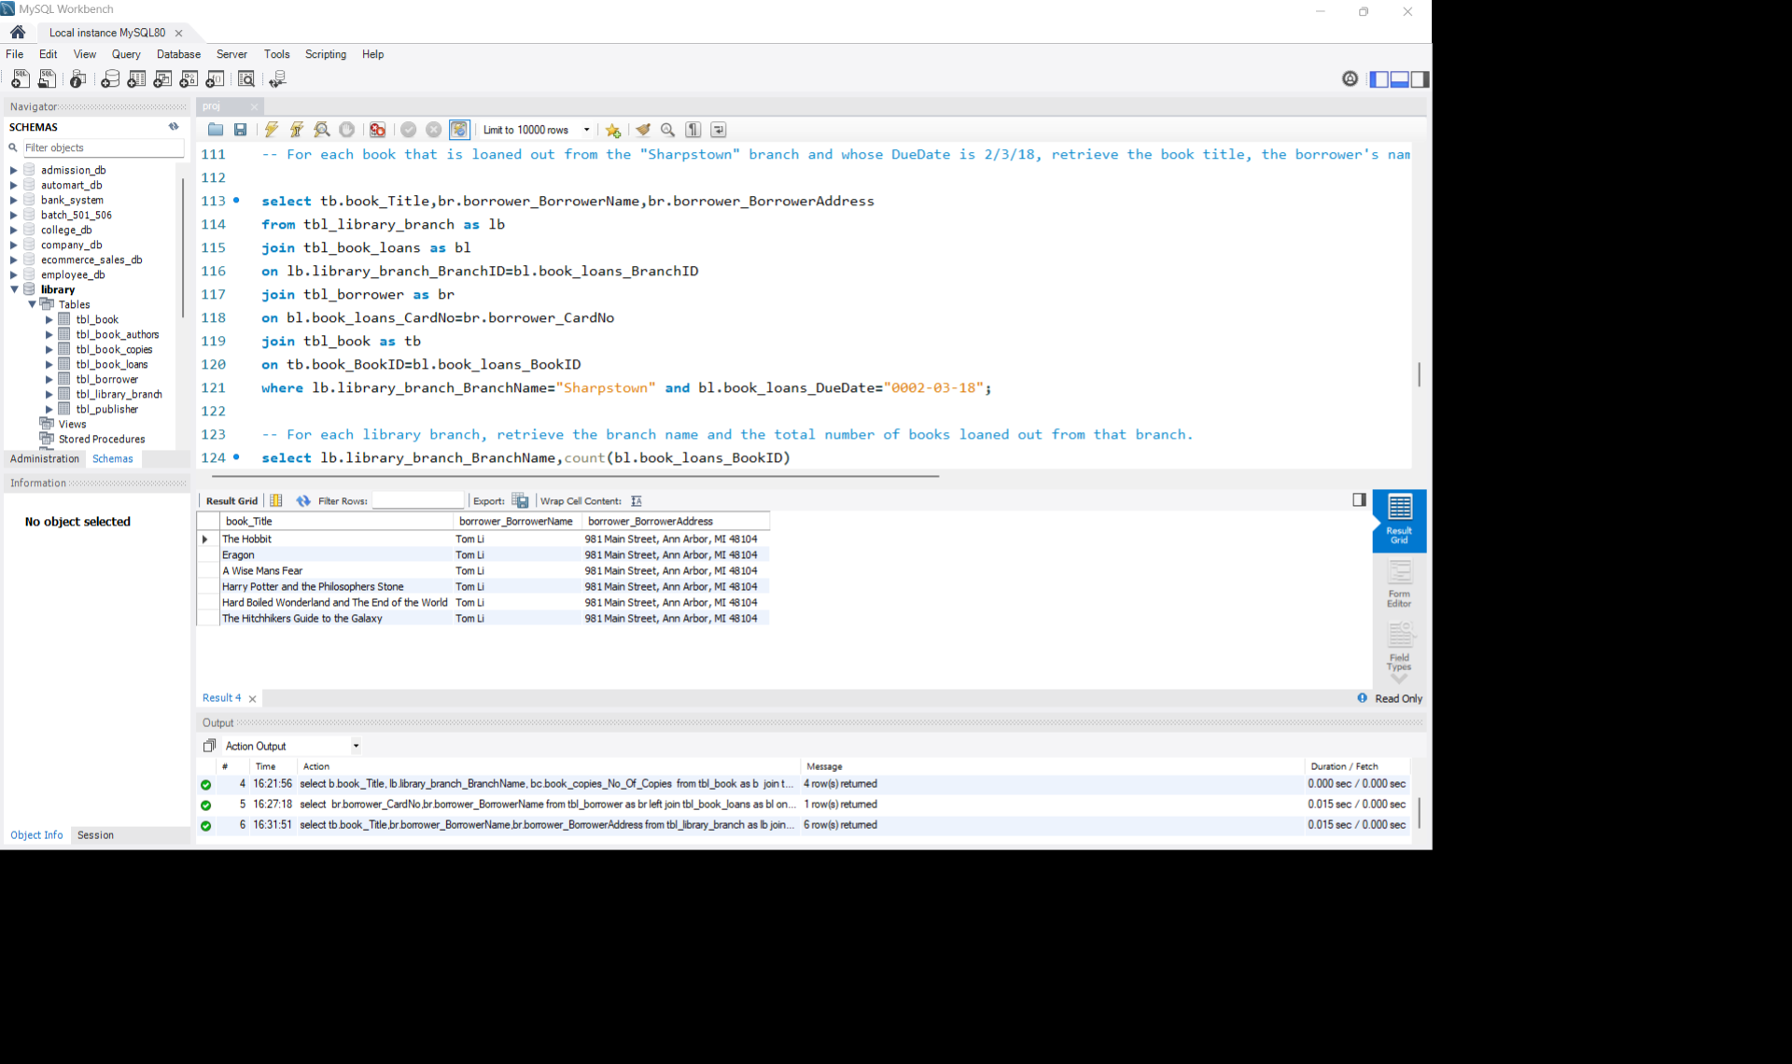
Q4 : For each book that is loaned out from the "Sharpstown" branch and whose DueDate is 2/3/18, retrieve the book title, the borrower's name, and the borrower's address.
Query
Output
Observation: The query joins four tables — tbl_library_branch, tbl_book_loans, tbl_borrower, and tbl_book — using their foreign key relationships. It filters records where the branch name is “Sharpstown” and the due date matches “0002‑03‑18”. This ensures only relevant loan transactions are displayed.
Result: The output lists six books (The Hobbit, Eragon, A Wise Man’s Fear, Harry Potter and the Philosopher’s Stone, Hard Boiled Wonderland and the End of the World, The Hitchhiker’s Guide to the Galaxy) all borrowed by Tom Li, residing at 981 Main Street, Ann Arbor, MI 48104.
Insight:-
This query supports effective loan tracking by helping the library monitor due books on a specific date, making it easier to manage returns, send reminders, and reduce overdue cases.

Slide 11
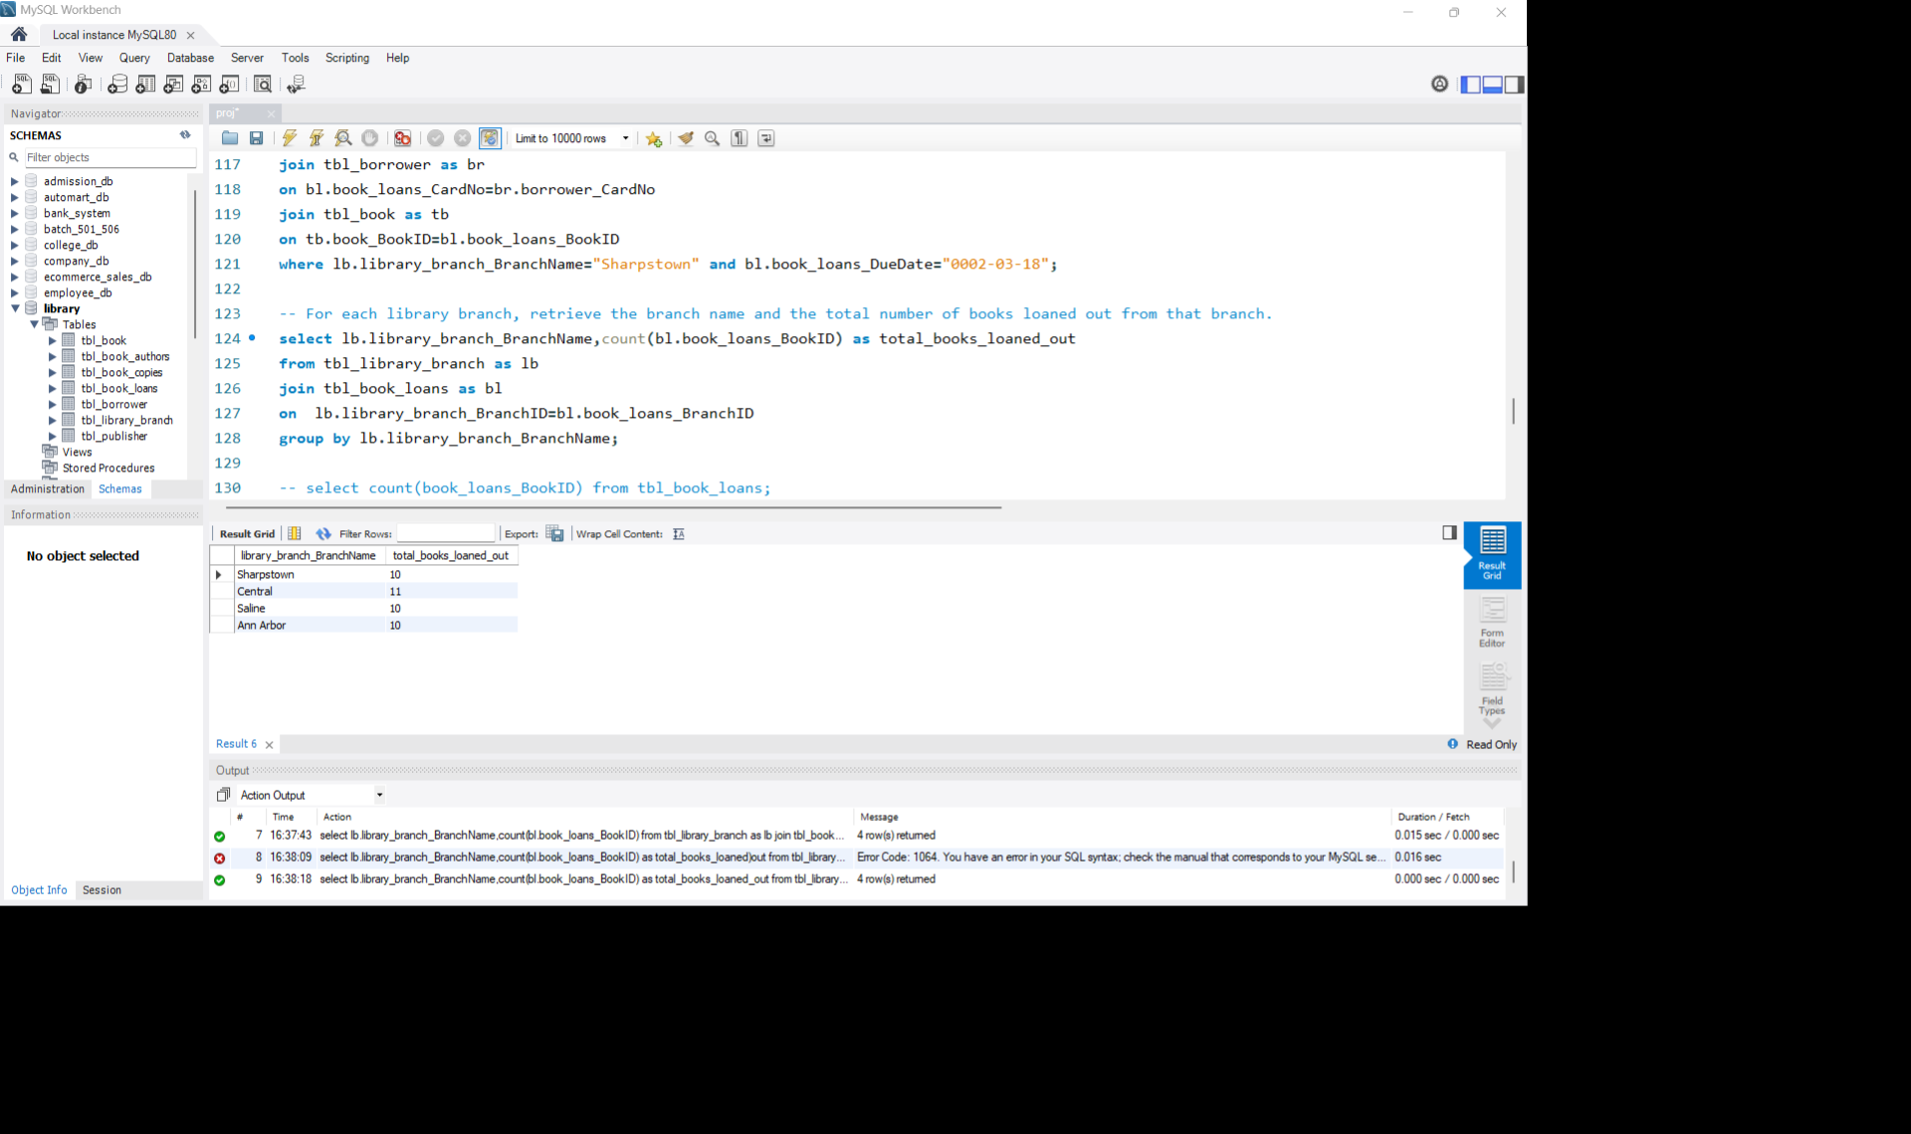
Q5: For each library branch, retrieve the branch name and the total number of books loaned out from that branch.
Query
Output
Observation:
The query joins the tbl_library_branch and tbl_book_loans tables using the foreign key relationship between BranchID. It then groups the results by library_branch_BranchName and uses the COUNT() function to calculate the total number of books loaned out per branch.
Result:
The output shows:
Sharpstown → 10 books loaned , Central → 11 books loaned, Saline → 10 books loaned, Ann Arbor → 10 books loaned
Insight:
This analysis helps the library measure branch performance by identifying branches with higher borrowing activity, which can support better resource allocation and operational planning.

Slide 12
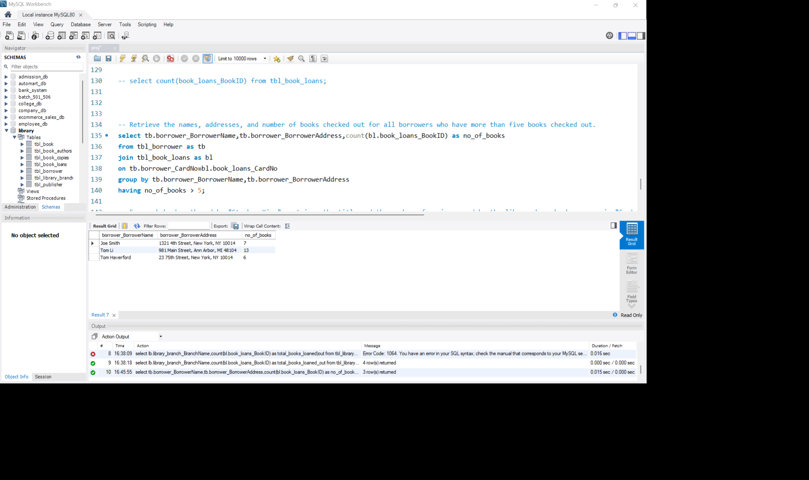
Q6: Retrieve the names, addresses, and number of books checked out for all borrowers who have more than five books checked out.
Query
Output:
Observation:
Joined tbl_borrower and tbl_book_loans using CardNo, grouped by borrower details, and filtered with HAVING no_of_books > 5 to find heavy borrowers.
Result:
Joe Smith – 7 books
Tom Li – 13 books
Tom Haverford – 6 books
Insight:
This query helps identify frequent library users and provides valuable information about borrowing behavior, which can help the library create loyalty programs or better understand reader preferences.

Slide 13
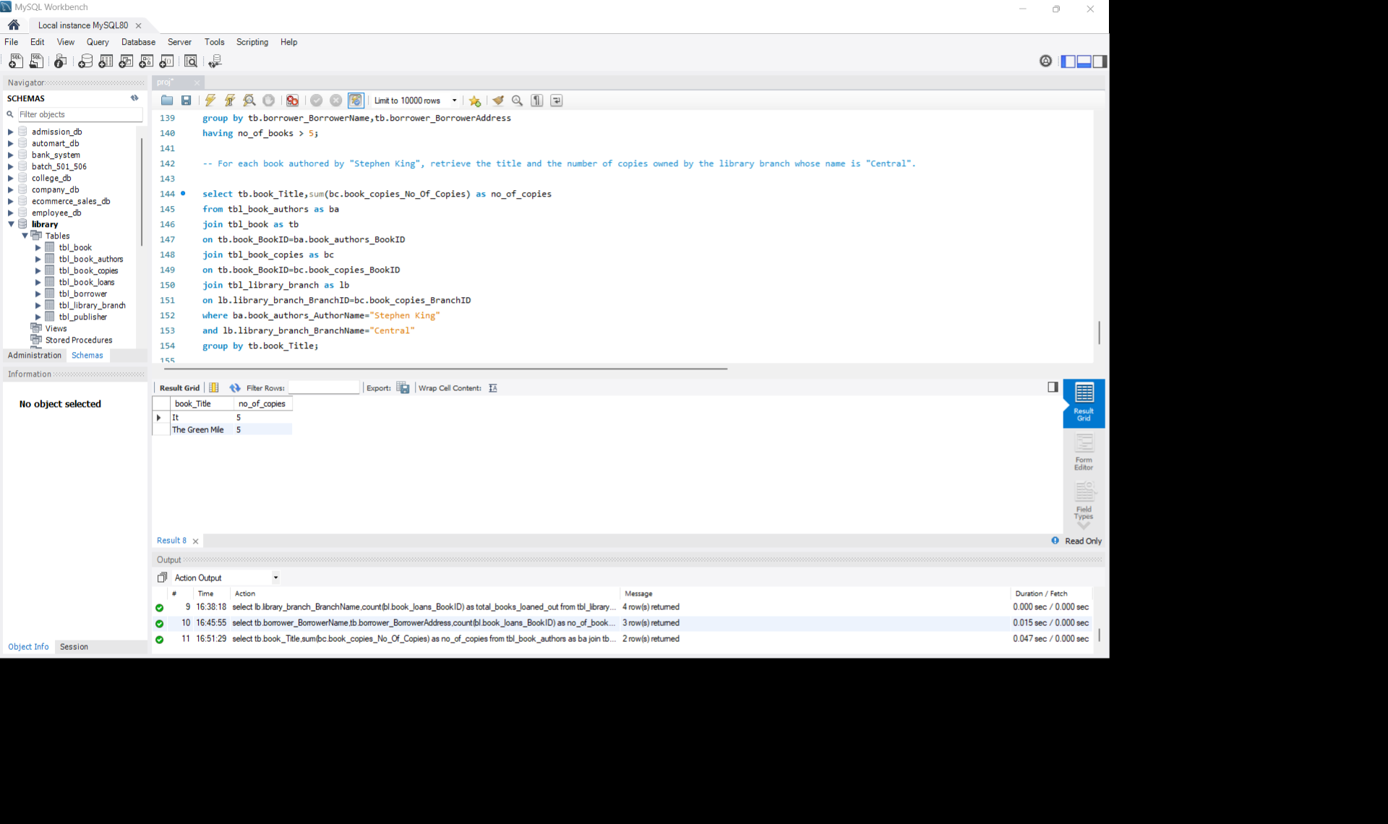
Q7: For each book authored by "Stephen King", retrieve the title and the number of copies owned by the library branch whose name is "Central".
Query
Output
Observation: Joined tbl_book_authors, tbl_book, tbl_book_copies, and tbl_library_branch using their foreign key relationships. Filtered by author name Stephen King and branch name Central, then grouped by book title to sum the total copies.
Result:
It – 5 copies
The Green Mile – 5 copies
Insight:
This analysis helps the library track the availability of books by a specific author and supports inventory management by ensuring that popular authors like Stephen King are adequately stocked in the Central branch.

Slide 14
Conclusion
The analysis helps track book availability across different library branches.
It identifies active and inactive borrowers within the library system.
The queries support efficient monitoring of due dates and borrowed books.
Branch-wise loan analysis helps measure library branch performance.
Borrower activity analysis helps understand reader behavior and engagement.
Author-wise and branch-wise inventory tracking improves stock management.
The overall analysis supports better decision-making and efficient library operations.

Slide 15
Q&A

Slide 16

Experiences & Challenges
Challenges Faced:
Designing proper table relationships and maintaining data integrity
using foreign keys
Improved understanding of table relationships, joins, aggregation functions, and data filtering techniques through hands-on implementation.
Handling data inconsistencies and missing values during CSV import
Faced challenges in managing multiple table joins and maintaining query accuracy while retrieving meaningful insights.
Enhanced problem-solving abilities by identifying efficient ways to analyze borrower activity, book availability, and branch performance.
Gained valuable experience in transforming raw database records into actionable business insights for better decision-making and inventory management.

Slide 17

Learning Experience:
Gained practical knowledge of SQL queries, joins, filtering, and aggregation techniques.
Improved understanding of database relationships and table connectivity. Learned how to analyze real-time library management data efficiently.
Enhanced problem-solving skills through complex query execution.
Developed the ability to transform raw data into meaningful business insights. Developed problem-solving skills while handling real-world data

Slide 18

THANK YOU

